Slide 1
TIC TAC TOE GAME
Presented by: Chanpreet, Gurpreet, Sukhjinder Singh
Presented to: Gurleen Kaur

Slide 2
Introduction
Tic Tac Toe Game is a simple, two player game. It is a game in which two players take turns in drawing either an ‘O’ or an ‘X’ in one square of grids consisting of nine squares. The winner is first player to get three of the same symbols in a row, column and diagonally.

Slide 3
PROJECT OVERVIEW
We use a 2d array to make Tic Tac Toe Game and along with it, we use various conditional loops and functions in it. Mainly, we use while loop and for loops to continue the game. Moreover, we create different functions and methods to mainly check the four conditions:
To check if the specific move is used by player.
Out of bounds
Who wins.
The board is full.

Slide 4
PROJECT OVERVIEW
Writing this program, we made use of the following libraries:
Java.util.Scanner;
We also made use of following functions.
For loop
If/else

Slide 5
Functions that are used
Create a TicTacToeGame class.
Create a main method in the TicTacToeGame class.
Firstly, printing the message using System.out.println (which is Let’s play Tic Tac Toe Game).
Secondly, import the scanner class and with the use of it, we ask the users for the names of the players.
Then, we create a 2d array (char [] [] board) to create 3*3 Tic Tac Toe board and use the void method (drawboard (char [] [] board)) to print the Tic Tac Toe board.

Slide 6
Continue…….
After that, create an object name ‘Symbol’ with ‘char’ datatype. Symbol variable is mainly used to keep track of which symbol is used by the player for the game.
Create a Boolean variable named isPlayer1 which we set to true.
Then, we set the position on the board to player’s symbol. And use the if else again to print out the player’s turn.
Create a two int variables (int row, int col) to get row and column number.
Again, we use the scanner function to ask the user about rows and columns to play the game.

Slide 7
Continue…….
Then, check the rows and columns are valid by using if else statement. Here, we use the if else statement because of two reasons. First to check, Are the rows and columns are out of bounds? And secondly, to check Is one of the players has made the move, which is already used by another player? We use a WHILE loop by setting the (while(true)) to continue the game.
After that, check whether the player has won by using new method (hasWon char [] [] board)) with static variable. Here, we check the rows, columns, and diagonals to get three of the same symbols.

Slide 8
Continue…….
Then, we use which player has won by using if else statement and printing the message for the player who has won using println method. To end the game, we create a Boolean variable called gameEnd and set it to the true.
Then, we use a method (isTied (char [] [] board)) with the help of Boolean to check whether the board is full or not. And here, we use the “isTied” variable. Here, again we use the Boolean variable called gameEnd and set it to the true.
At last, we use a drawboard(board) to print the tic tac toe game board. And when one of the players has won, we end the game.

Slide 9
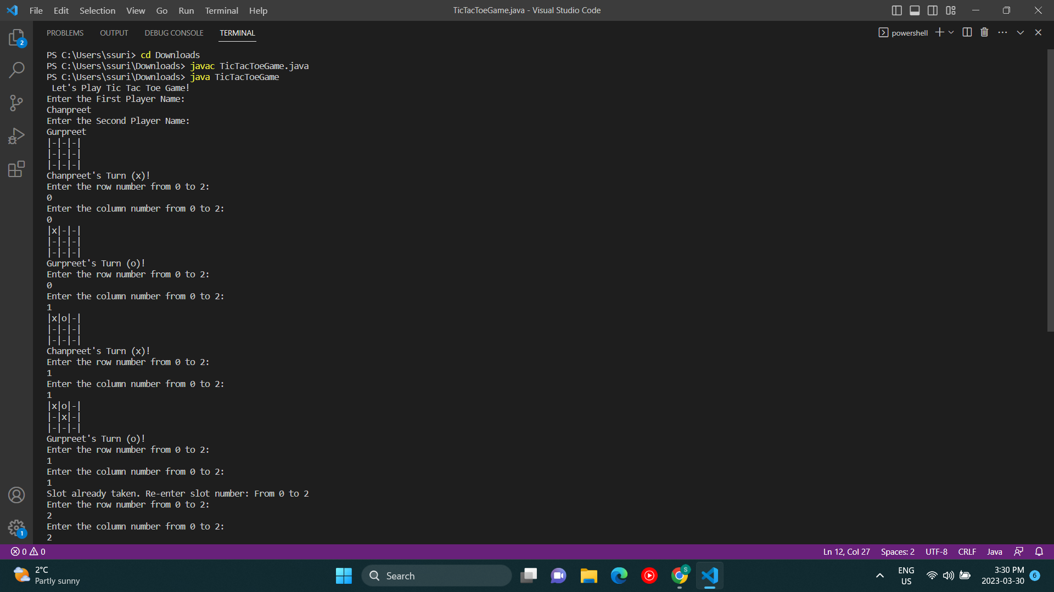
Screenshot of the output

Slide 10
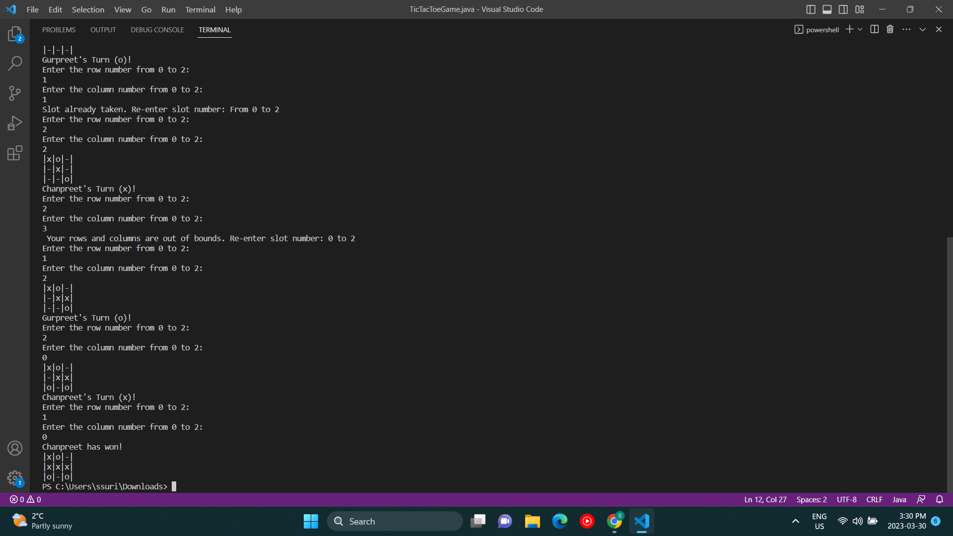
Screenshot of the output

Slide 11

THANKS FOR LISTENING

